Slide 1
Chapter 7 Education, Training, and Earning Differentials: The Theory of Human Capital

Slide 2
Chapter outline
This chapter examines the role of education and on-the-job training as a source of earning differentials.
The essence of human capital theory is that expenditures on education and training are investments individuals make it themselves to increase their market skills, productivity, and earnings.

Slide 3
The Theory of Human Capital
Over two century earlier, Adam Smith introduced the idea of human capital. However, Smith’s insight was largely neglected by later economists, who concentrated on investment in physical capital.
In the late 1950s, however, economists such as Jacob Mincer and Nobel laureates Theodore Schultz and Gary Becker rediscovered Smith’s thought and developed it into the “Theory of Human Capital.”
The type of human capital investment that has received most attention from labor economics is education and training.

Slide 4
The Theory of Human Capital
The Investment Decision:
Should an individual attend a four year university or college?
From a human capital perspective, the depends on the monetary benefits relative to the costs.
The precise nature of these benefits and costs is illustrated using the age/ earnings profile resulting from the following two different investment strategies:
First: To finish high school and then begin full-time work at age 18, working continuously until age 65.
Second: To attend college for four years from age 18 to 21, then work continuously from age 22 to retirement at age 65.

Slide 5
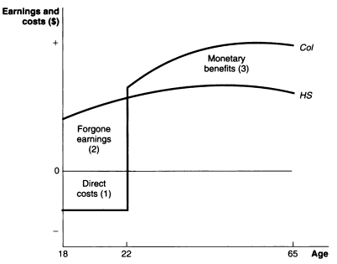
The Theory of Human Capital
The lines HS
and Col are the
age/ earnings
Profiles of a
representative
High school and
college graduate,
Respectively.
The cost of a
college education is the direct cost of tuition, books, and so on (area 1) and the opportunity cost of forgone earnings (area 2). The monetary benefits of attending college is the higher earnings that a college degree makes possible (area 3).

Slide 6
The Theory of Human Capital
To compare the benefits with the costs, the benefits must be calculated in terms of their present value.
Present value:
For the high school graduate, the present value of the lifetime stream of income ( ) is:
Or,

Slide 7
The Theory of Human Capital
For the college graduate, the present value of the lifetime stream of income ( ) is:
Or,

Slide 8
The Theory of Human Capital
Two Investment Decision Rules
First: To compute the net present value of the each income stream and select the one that is the highest . This choice results in the human capital investment that maximizes the discounted value of the lifetime income.

Slide 9
The Theory of Human Capital
Two Investment Decision Rules
Second: To decide whether college is a good investment is to calculate the internal rate of return (r) and compare it with the market rate of interest (i): if the internal rate of return is greater than or equal to the market rate of interest, the investment is profitable, i.e.
To calculate r, equalizing the net present value of the two income streams:

Slide 10
Implication of Human Capital Theory
The following are the some implications of human capital theory:
1. Cost.
2. Age.
3. Labor Force Continuity.
4. Earning Differentials
5. The size of Earning Differentials.

Slide 11
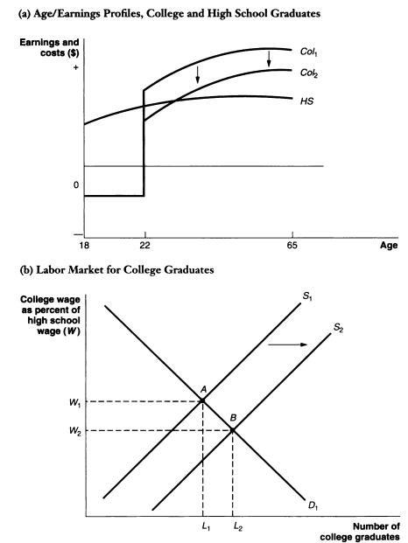
Implication of Human Capital Theory
5. The size of Earning Differentials:

Slide 12
On the Job Training
Formal education is one type of human capital investment. On–the-job (OJT) training is a second type.
OJT involves both current costs and future benefits.
The cost of OJT are incurred by the firm in the form of direct costs of classroom instruction or additional supervision, and indirect cost from lesser amount of output that new worker can produce during training.
Workers may also bear some of the cost of acquiring OJT by agreeing to work at reduced wages during the training period.

Slide 13
On the Job Training
Benefits of OJT:
The benefit to the firm is that its workforce will be more productive, and this greater productivity will result in greater profit.
Workers benefit because they gain additional skills and experience that increase their earning power and bargaining strength in the labor market.

Slide 14
On the Job Training: General versus Specific Training
Gary Becker pointed that there are two conceptually distinct forms of training-
General On-the-job training
Specific On-the-job training
1. General on-the job training: the training that increases a worker’s productivity not only at the firm providing it, but also at other firms in the labor market.
A clear-cut example is apprenticeship training for a craft such as electrician or carpenter where skills imparted are of general value throughout the industry.

Slide 15
On the Job Training: General versus Specific Training
Specific On-the-job training:
Specific on-the-job training increases the worker’s productivity only at the firm providing it; at other firms the training is of no net value. One source of skill specificity stems from unique features of the firm’s production process.
For example, a telephone lineman develops skills that are, to a large degree, of use only to the telephone company.

Slide 16
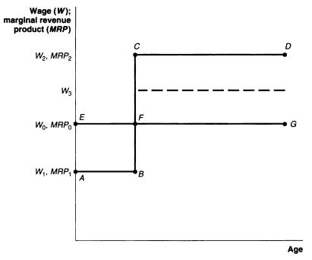
On the Job Training: Benefits and Costs

Slide 17
Implication of on the Job Training
Investment in human capital in the form of on-the-job training has a number of implications with respect to observed labor market outcomes. Five such implications are briefly discussed below:
Employee turnover
The minimum wage
Internal labor market
Indeterminacy of wages
Age/ Earning profiles

Slide 18
Implication of on the Job Training
Employee turnover:
Specific OJT provides a strong incentive to both firms and workers to reduce turnover from quits and layoffs.
The theory also predicts that the quit rate will decrease with the age of workers since their amount of specific training and, hence, potential earnings loss from quitting grow with the tenure on the job.

Slide 19
Implication of on the Job Training
The Minimum Wage:
To make training a profitable venture for the firm, the teenaged worker must invest in himself or herself by working at a relatively low wage (W1).
However, a minimum wage floor may prevent this process if minimum wage is set up at W0. At this wage the employer no longer finds it profitable to provide general training because the cost of labor exceeds the worker’s productivity.

Slide 20
Implication of on the Job Training
Internal labor market:
If all jobs skills were acquired through general OJT, there would be no internal labor markets since firms could readily hire a worker in the external labor market.
the more important specific training is as a source of job skills, however, the less reliance the firm will put on outside recruitment of labor and the greater emphasis it will put on internal promotion and advancement as a means of filling job vacancies.

Slide 21
Implication of on the Job Training
Indeterminacy of wage:
The specific OJT leads to an area of indeterminacy in wage rates.

Slide 22
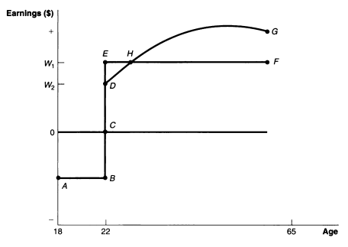
Implication of on the Job Training
Age/ Earning profiles:

